Slide 1

CSE205
Data Structures and Algorithms
Lecture #0
The kick start session

Slide 2
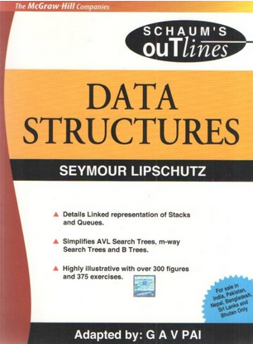
Course details
CSE205
LTP – 3 0 2 [3 lectures, 2 practicals /week]
Book to Follow
Data Structures (Schaums' Outlines Series)
Author - Seymour Lipschutz

Slide 3
Course Orientation – CSE205
COMPETITIVE EXAMINATION (Higher Education) KNOWLEDGE ENHANCEMENT PLACEMENT EXAMINATION(Mass Recruiters)

Slide 4
Course Assessment Model
CSE205 Marks break up*
Attendance 5
CA (Two best out of Three ATs) 25
MTT* 20
ETE 50
Total 100

Slide 5
Detail of Academic Tasks
CSE205
AT1: Code/Algorithm based test Week 5
AT2: Code/Algorithm based test Week 10 (After MTT)
AT3: Code/Algorithm based test Week 13 (After MTT)

Slide 6
MOOCs
Name
Introduction To Data Structures and Algorithms
Organization
NPTEL
Benefits
All the CAs will be exempted based on the proctored exam result
Note:
1. Students have choice to appear for Academic Task or MOOCs etc.
2. The student may appear for both, In this case best obtained marks will be considered.

Slide 7

The course contents CSE205
Introduction to data structures
Computation of complexity
Arrays, Sorting & Searching
Linked List
Stack and Queues
Recursions
Trees
Hashing
Graphs

Slide 8

The hitch…
The BURNING questions in mind…
Why are we learning data structures?
What will be the course outcome?

Slide 9
What will be the course outcome?
Describe the process to find efficiency of algorithms using asymptotic notations
Illustrate the importance of linked list in context of real world problems
Differentiate the stack and queue data structures for problem solving
Practice of recursion in iteration process and tree data structure
Analyze the effectiveness of AVL Tree and Heap Data Structures
Use of graph and hashing techniques in problem solving

Slide 10
Program Outcomes achieved from the course
Engineering knowledge: Apply the knowledge of mathematics, science, engineering fundamentals, and an engineering specialization to the solution of complex engineering problems.
Design/development of solutions: Design solutions for complex engineering problems and design system components or processes that meet the specified needs with appropriate consideration for the public health and safety, and the cultural, societal, and environmental considerations.
Design/development of solutions: Design solutions for complex engineering problems and design system components or processes that meet the specified needs with appropriate consideration for the public health and safety, and the cultural, societal, and environmental considerations.

Slide 11
Program Outcomes achieved from the course
Conduct investigations of complex problems: Use research-based knowledge and research methods including design of experiments, analysis and interpretation of data, and synthesis of the information to provide valid conclusions.
Modern tool usage: Create, select, and apply appropriate techniques, resources, and modern engineering and IT tools including prediction and modeling to complex engineering activities with an understanding of the limitations.
Life-long learning: Recognize the need for, and have the preparation and ability to engage in independent and life-long learning in the broadest context of technological change.

Slide 12
Program Educational Objectives achieved from the course
Those employed in industry will be able to apply fundamentals of technical knowledge in multidisciplinary areas related to automobile, thermal, manufacturing and mechatronics by participating as top professionals in leading Industries.
Pursue advanced education, research and development in science, engineering, and technology, as well as other professional endeavors.
Be receptive to professional and ethical responsibilities for the impact of engineering solutions on society being as a successful innovator, consultant and entrepreneur

Slide 13
Why are we learning data structures?
Helps us to
  get an idea of running time of algorithm
  implement efficient algorithms
  decide on hardware requirements
  decide What is feasible vs. What is impossible
  prepare job interviews

Slide 14

Next Class: Basic Data Structures

